Slide 1
Spotted Lanternfly and the control of Ailanthus altissima (Tree of Heaven)
Hayden Stebbins
Haydensharvest.com
haydenstebbins@gmail.com
IG: @haydensharvest

Slide 2
https://en.wikipedia.org/wiki/Yosemite_National_Park

Slide 3
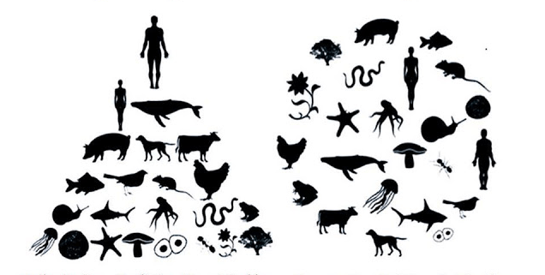

Slide 4
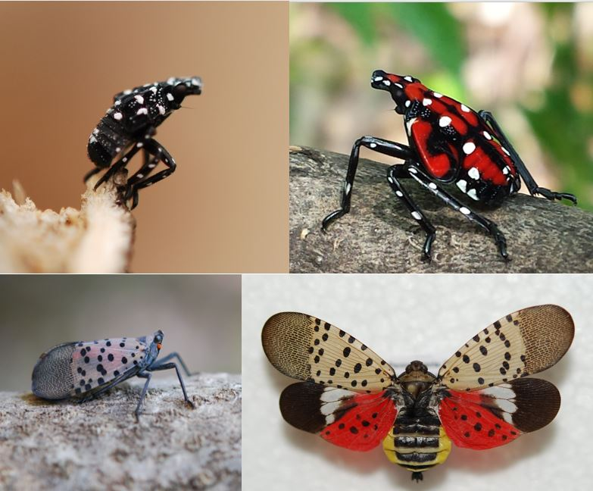
Lycorma delicatula Spotted Lanternfly
http://info.ncagr.gov/blog/2018/04/25/the-spotted-lanternfly-spotted-in-virginia/

Slide 5
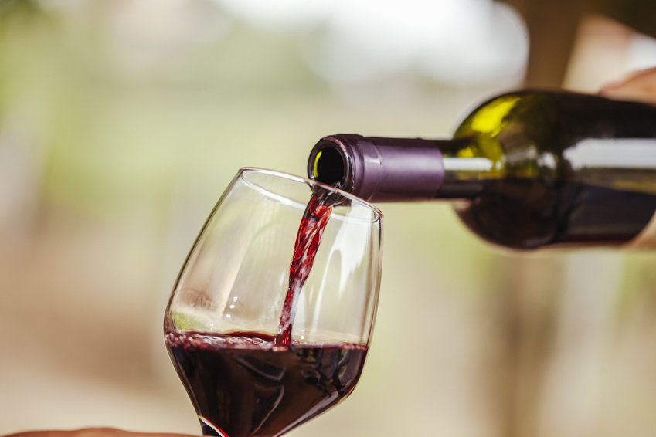
What is at risk?
Almonds
Apples
Apricots
Cherries
Grapes
Hops
Maple Trees
Nectarines
Oak Trees
Peaches
Pine Trees
Plums
Poplar Trees
Sycamore Trees
Walnut Trees
Willow Trees
https://www.sciencedaily.com/releases/2018/02/180221091326.htm
https://www.aphis.usda.gov/aphis/resources/pests-diseases/hungry-pests/the-threat/spotted-lanternfly/spotted-lanternfly?utm_campaign=crosby-2017&utm_source=hungrypests-com&utm_medium=redirect&utm_keyword=/the-threat/spotted-lanternfly.php

Slide 6
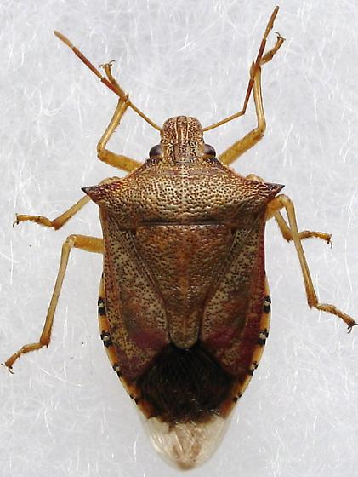
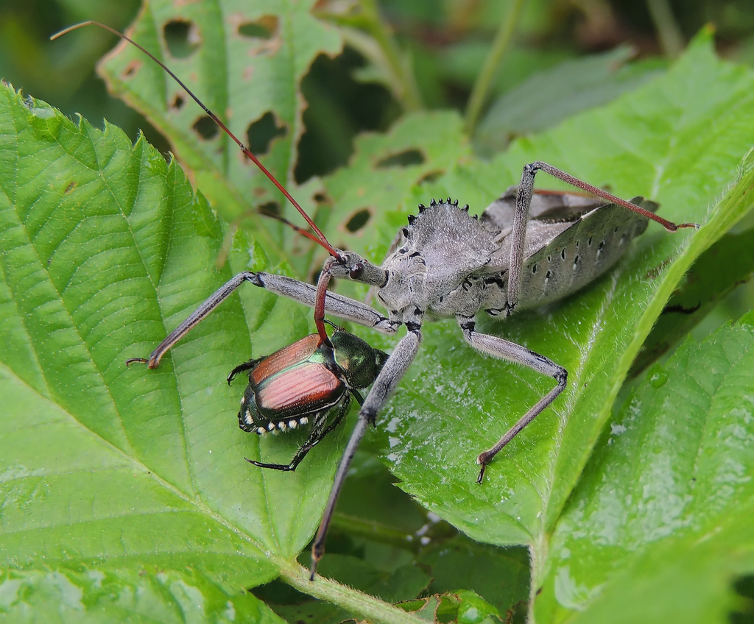
Native observed predators (Barringer, 2016)
Arilus cristatus
Apoecilus cynicus
https://www.marylandbiodiversity.com/viewSpecies.php?species=10191
https://bugguide.net/node/view/901870

Slide 7
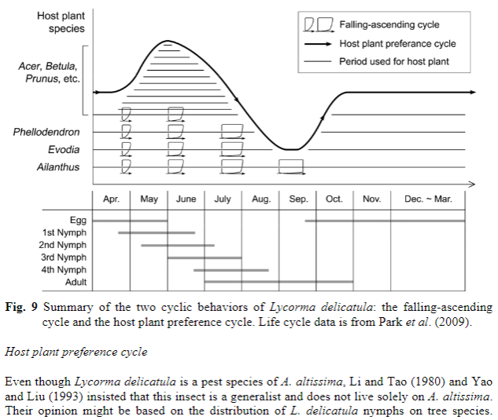
Kim, J. G., Lee, E., Seo, Y., & Kim, N. (2011). Cyclic Behavior of Lycorma delicatula (Insecta: Hemiptera: Fulgoridae) on Host Plants. Journal of Insect Behavior,24(6), 423-435. doi:10.1007/s10905-011-9266-8

Slide 8
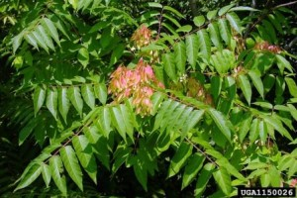
Target species for control
Ailanthus altissima (Tree of Heaven) – Tier 4
Tetradium daniellii (Bee Bee Tree) - ?
Phellodendron amurense (Amur Cork Tree) – Tier 2
Vitis spp. is a host when none other is available. Not covered.
https://cipwg.uconn.edu/tree-of-heaven/

Slide 9
Ailanthus ethnobotany
Intestinal ailments, and more (Hu 1979)
Timber, cabinetry, furniture, tool handles (Hu 1979)
Paper (Baptista et al. 2014; Ferreira et al. 2013)
Firewood comparable to black walnut, white oak, birch (Hu 1979)
Shantung or Pongee Silk from Ailanthus Silkmoth (Samia cynthia) (Kowarik, 2007)
Goat fodder (Kúdela and Mamoňová 2006; Azim et al. 2002)
https://www.tradesy.com/i/galina-ivory-white-rose-quartz-lace-silk-shantung-raw-silk-1153-strapless-aline-tulip-ruffle-back-se/4662724/

Slide 10
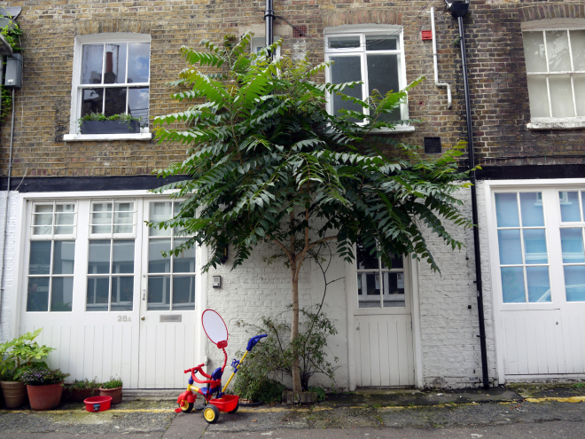
Ailanthus altissima
Salt tolerant (Bicknell and Smith 1975)
Drought tolerant (Trifilò et al. 2004)
Allelopathic (Heisey 1996; Heisey 1997; Feo et al. 2003; Lawrence et al. 1991; Gómez-Aparicio and Canham 2008)
Pollution tolerant (Kowarik and Säumel 2007)
Stump and root sprouts
Prolific wind distributed seeds
One of the fastest growing temperate trees (Heisey 1997)
Occupies a unique niche, need to encourage species to replace it roadside.
https://thestreettree.com/tag/ailanthus-altissima/

Slide 11
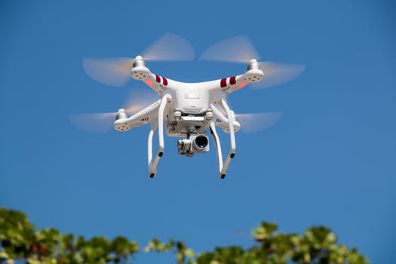
Locating Ailanthus
Drones or Helicopters: look for seed clusters in winter (Rebbeck et al. 2015)
Drones to administer treatment?
DOT employees
Imap Invasives
iNaturalist – education
https://www.pexels.com/search/drone/

Slide 12
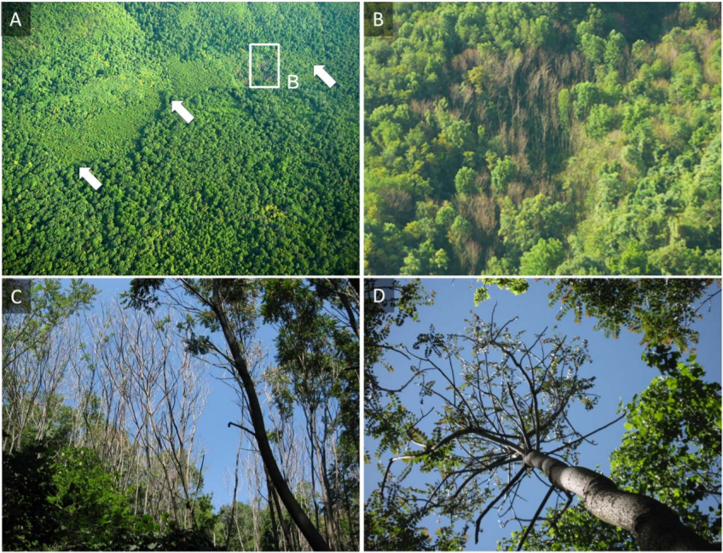
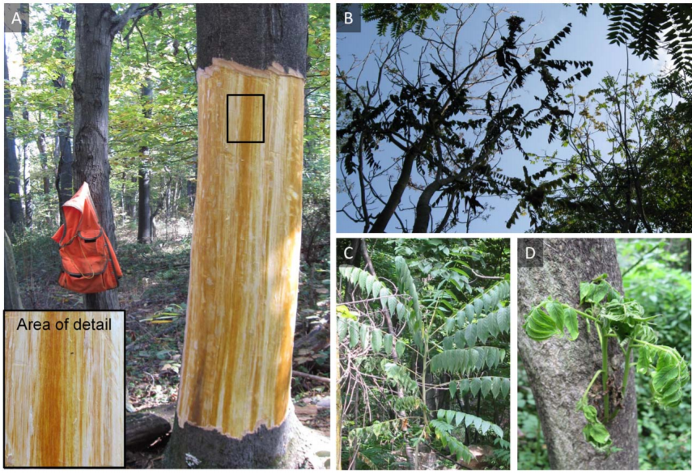
Verticillium nonalfalfae
Host specific, some effect on Devil’s Walkingstick and Striped Maple (Kasson et al. 2015)
Very effective, currently present in Pennsylvania, Ohio, Virginia, Austria (Kasson et al. 2014; Kasson et al. 2015; Rebbeck et al. 2013; Snyder et al. 2013; Snyder et al. 2014; Schall and Davis 2009; Harris et al. 2013; Maschek and Halmschlager 2016)
100 inoculations resulted in >14,000 Ailanthus deaths (Kasson et al. 2014)
Potential to spread with Eucryptorrhynchus brandti (Snyder et al. 2012; Ding et al. 2006)
Trees on roadsides and precarious areas must be manually removed, then perhaps inoculated
Kasson et al. 2014

Slide 13
Private and smaller landowners
Organic Control of Ailanthus
Timing: Late fall, winter, or early spring
Tools: Short drawknife (6")
Technique: Starting at the base of the tree, draw knife up under bark of tree, removing a strip about 18"-24" long with each pass; completely remove bark all around tree. Hint: turning the knife around so the sharp edge is up makes it easier, since the knife doesn't bite too deep. You are removing only the bark; you are not actually girdling the tree.
Follow-up: After one growing season, re-visit the treated trees. Late fall through spring is a good time, since the underbrush has died down and you can see easily. Observe regrowth and stomp down stump sprouts. Pull any small seedlings, if present. Repeat after 2nd growing season, if necessary. Be wary in windy weather -- you have deliberately weakened this tree and it will eventually fall down. Usually it loses much of its mass before this happens and doesn't cause much damage to other vegetation, but beware and be safe. (Baran 2010)

Slide 14
SARE Grant mushroom cultivation
Inoculate debarked Ailanthus with Pleurotus ostreatus (Oyster Mushroom) (Baran 2010)
Grant used drill and plug, I recommend trying Hypo-hatchet with liquid tissue cultures (McCoy 2013)

Slide 15
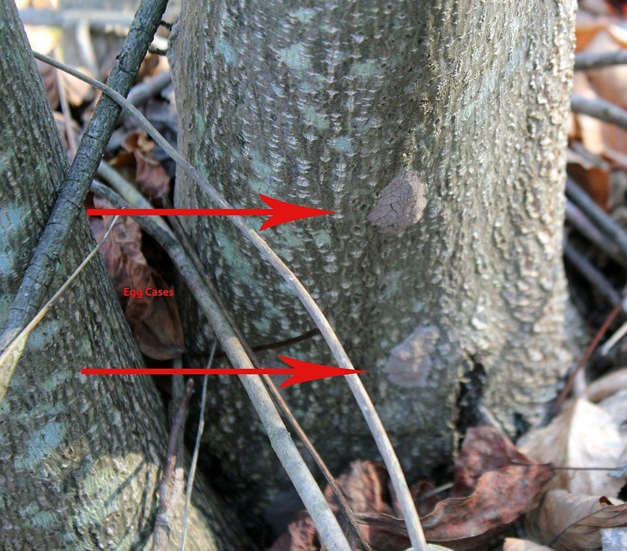
Manual removal
Firewood, tool handles, furniture
Mushroom production (near houses, not roads)
Chipping destroys eggs (Cooperbrand et al. 2018)
Inoculate with Verticillium nonalfalfae as followup
https://news.psu.edu/photo/516221/2018/04/13/spotted-lanternfly-egg-masses

Slide 16
Education
Spread the word. Human element makes things interesting.
One 60 second video highlighting Spotted Lanternfly yielded an average of 121 emails and 57 calls per day during a 75-day campaign, roughly 10x the normal amount (Barringer 2018).

Slide 17
Works Cited
Azim, A., Khan, A. G., Ahmad, J., Ayaz, M., & Mirza, I. H. (2002). Nutritional Evaluation of Fodder Tree Leaves with Goats. Asian-Australasian Journal of Animal Sciences,15(1), 34-37. doi:10.5713/ajas.2002.34
Baptista, P., Costa, A. P., Simões, R., & Amaral, M. E. (2014). Ailanthus altissima: An alternative fiber source for papermaking. Industrial Crops and Products,52, 32-37. doi:10.1016/j.indcrop.2013.10.008
Baran, J. (2010). Field study of technique for combining low-cost, herbicide-free control of woody invasives, in particular Ailanthus altissima, with production of edible mushrooms. Retrieved from https://projects.sare.org/sare_project/fnc07-670/
Barringer, Lawrence. (2018). Spotted Lanternfly Outreach: Opening the Floodgates. Conference: USDA Interagency Research Forum on Invasive Species.
Barringer, L. E., & Smyers, E. (2016). Predation of the Spotted Lanternfly,Lycorma delicatula(White) (Hemiptera: Fulgoridae) by Two Native Hemiptera. Entomological News,126(1), 71-73. doi:10.3157/021.126.0109
Bicknell, S. H., & Smith, W. H. (1975). Influence of soil salt, at levels characteristic of some roadside environments, on the germination of certain tree seeds. Plant and Soil,43(1-3), 719-722. doi:10.1007/bf01928536
Cooperband, M. F., Mack, R., & Spichiger, S. (2018). Chipping to Destroy Egg Masses of the Spotted Lanternfly, Lycorma delicatula (Hemiptera: Fulgoridae). Journal of Insect Science,18(3). doi:10.1093/jisesa/iey049
Ding, Jianqing & Wu, Yun & Zheng, Hao & Fu, Weidong & Reardon, Richard & Liu, Min. (2006). Assessing potential biological control of the invasive plant, tree-of-heaven, Ailanthus altissima. Biocontrol Science and Technology. 16. 10.1080/09583150500531909.
Feo, V. D., Martino, L. D., Quaranta, E., & Pizza, C. (2003). Isolation of Phytotoxic Compounds from Tree-of-Heaven (Ailanthus altissimaSwingle). Journal of Agricultural and Food Chemistry,51(5), 1177-1180. doi:10.1021/jf020686
Ferreira, P. J., Gamelas, J. A., Carvalho, M. G., Duarte, G. V., Canhoto, J. M., & Passas, R. (2013). Evaluation of the papermaking potential of Ailanthus altissima. Industrial Crops and Products,42, 538-542. doi:10.1016/j.indcrop.2012.06.030
Gómez-Aparicio, L., & Canham, C. D. (2008). Neighbourhood analyses of the allelopathic effects of the invasive tree Ailanthus altissima in temperate forests. Journal of Ecology,96(3), 447-458. doi:10.1111/j.1365-2745.2007.01352.x
Harris, P. T., Cannon, G. H., Smith, N. E., & Muth, N. Z. (2013). Assessment of plant community restoration following Tree-of-Heaven (Ailanthus altissima) control by Verticillium albo-atrum. Biological Invasions,15(9), 1887-1893. doi:10.1007/s10530-013-0430-2
Heisey, R. M. (1996). Identification of an Allelopathic Compound from Ailanthus altissima (Simaroubaceae) and Characterization of its Herbicidal Activity. American Journal of Botany,83(2), 192. doi:10.2307/2445938
Heisey, R.M. (1997). Allelopathy and the Secret Life of Ailanthus altissima. Arnoldia, Fall 1997, 28-36.
Hu, S. (1979). Ailanthus. Arnoldia, 39(2), 29-50.
Kasson, M. T., O’Neal, E. S., & Davis, D. D. (2015). Expanded Host Range Testing for Verticillium nonalfalfae: Potential Biocontrol Agent Against the Invasive Ailanthus altissima. Plant Disease,99(6), 823-835. doi:10.1094/pdis-04-14-0391-re
Kasson, M. T., Short, D. P., Oneal, E. S., Subbarao, K. V., & Davis, D. D. (2014). Comparative Pathogenicity, Biocontrol Efficacy, and Multilocus Sequence Typing of Verticillium nonalfalfae from the Invasive Ailanthus altissima and Other Hosts. Phytopathology,104(3), 282-292. doi:10.1094/phyto-06-13-0148-r
Kowarik, I., & Säumel, I. (2007). Biological flora of Central Europe: Ailanthus altissima (Mill.) Swingle. Perspectives in Plant Ecology, Evolution and Systematics,8(4), 207-237. doi:10.1016/j.ppees.2007.03.002
Kúdela, J. & Mamoňová, M. (2006). Tree-of-heaven wood (Ailanthus altissima, Mill.) - structure and properties. Conference: Wood structure and properties 2006.
Lawrence, J. G., Colwell, A., & Sexton, O. J. (1991). The Ecological Impact of Allelopathy in Ailanthus altissima (Simaroubaceae). American Journal of Botany,78(7), 948. doi:10.2307/2445173
Maschek, O., & Halmschlager, E. (2016). First Report of Verticillium Wilt on Ailanthus altissima in Europe Caused by Verticillium nonalfalfae. Plant Disease,100(2), 529-529. doi:10.1094/pdis-07-15-0733-pdn
McCoy, P. (2013, September 02). Radical Mycology's Mushroom Cultivation for Remediation 1/3. Retrieved from https://www.youtube.com/watch?v=hwpICWiTW9U
Rebbeck, J., Malone, M. A., Short, D. P., Kasson, M. T., Oneal, E. S., & Davis, D. D. (2013). First Report of Verticillium Wilt Caused by Verticillium nonalfalfae on Tree-of-Heaven (Ailanthus altissima) in Ohio. Plant Disease,97(7), 999-999. doi:10.1094/pdis-01-13-0062-pdn
Schall, M. J., & Davis, D. D. (2009). Verticillium Wilt of Ailanthus altissima: Susceptibility of Associated Tree Species. Plant Disease,93(11), 1158-1162. doi:10.1094/pdis-93-11-1158
Sladonja, B., Sušek, M., & Guillermic, J. (2015). Review on Invasive Tree of Heaven (Ailanthus altissima (Mill.) Swingle) Conflicting Values: Assessment of Its Ecosystem Services and Potential Biological Threat. Environmental Management,56(4), 1009-1034. doi:10.1007/s00267-015-0546-5
Snyder, A. L., Kasson, M. T., Salom, S. M., Davis, D. D., Griffin, G. J., & Kok, L. T. (2013). First Report of Verticillium Wilt of Ailanthus altissima in Virginia Caused by Verticillium nonalfalfae. Plant Disease,97(6), 837-837. doi:10.1094/pdis-05-12-0502-pdn
Snyder, A., Salom, S., & Kok, L. (2014). Survey of Verticillium nonalfalfae (Phyllachorales) on tree-of-heaven in the southeastern USA. Biocontrol Science and Technology,24(3), 303-314. doi:10.1080/09583157.2013.860426
Snyder, A., Salom, S., Kok, L., Griffin, G., & Davis, D. (2012). Assessing Eucryptorrhynchus brandti (Coleoptera: Curculionidae) as a potential carrier for Verticillium nonalfalfae (Phyllachorales) from infected Ailanthus altissima. Biocontrol Science and Technology,22(9), 1005-1019. doi:10.1080/09583157.2012.707639
Trifilò, P., Raimondo, F., Nardini, A., Gullo, M. A., & Salleo, S. (2004). Drought resistance of Ailanthus altissima: Root hydraulics and water relations. Tree Physiology,24(1), 107-114. doi:10.1093/treephys/24.1.107

Slide 18
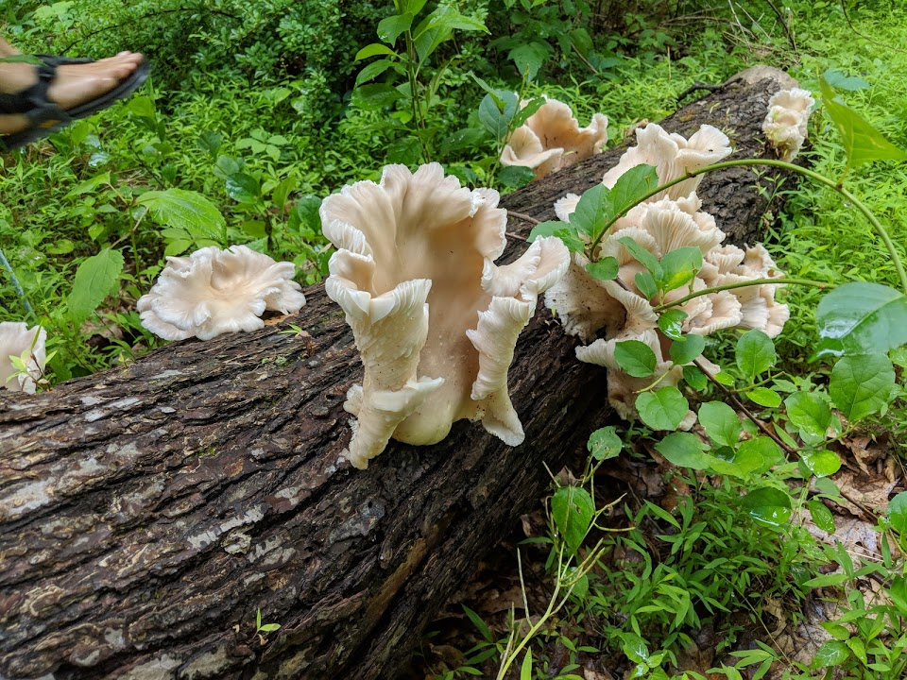
Thank you
Hayden Stebbins
haydenstebbins@gmail.com
Haydensharvest.com
Instagram: @haydensharvest

