Slide 1
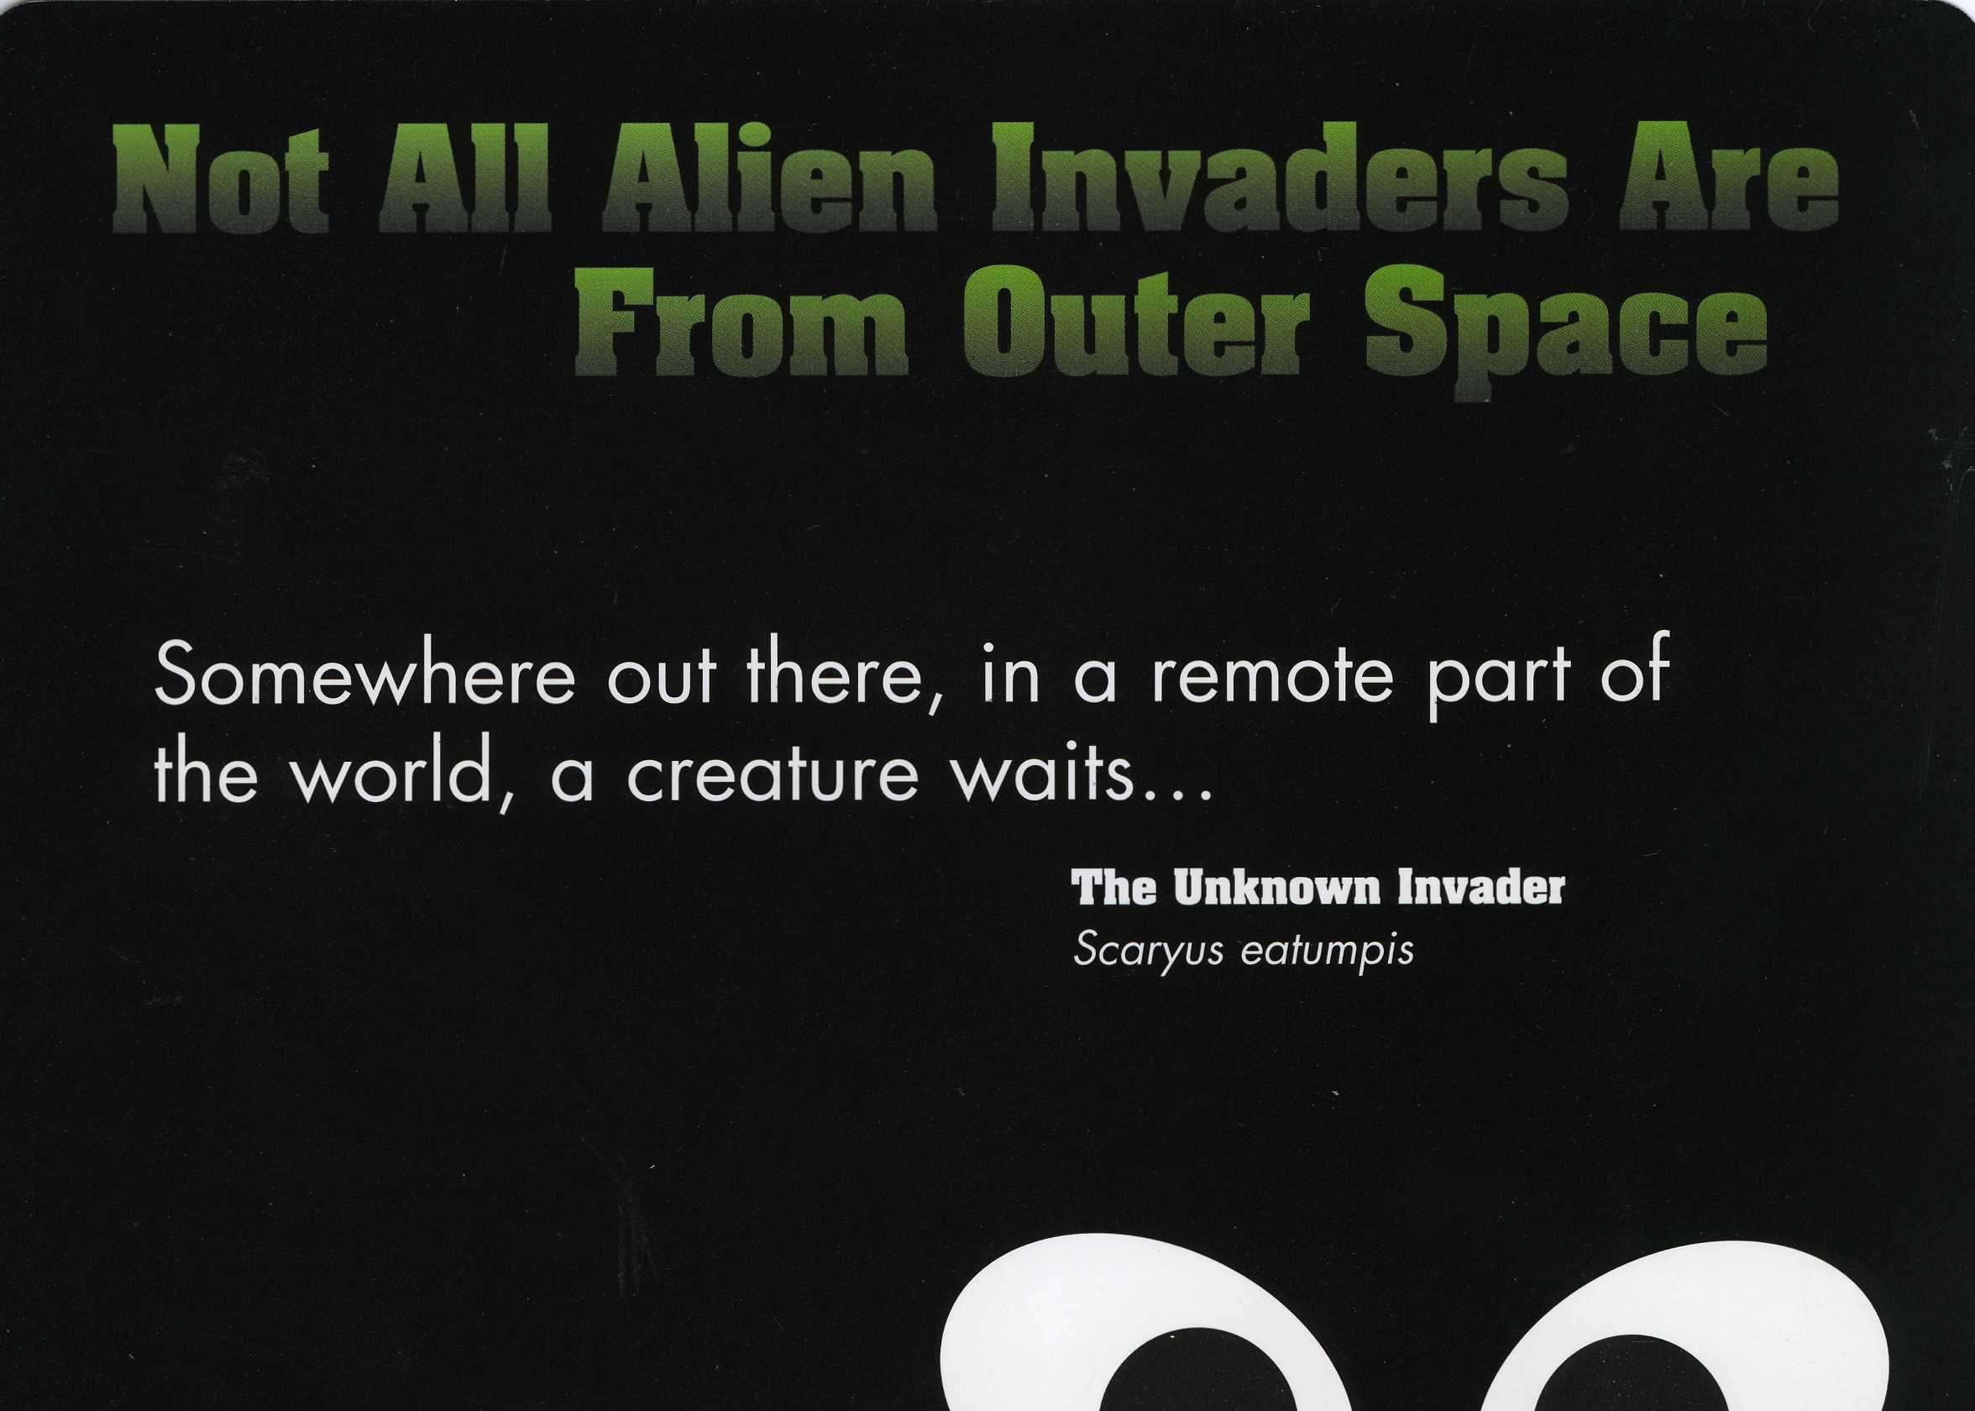

Slide 2
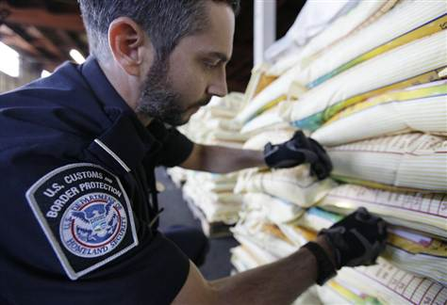
US food supply threatened: Foreign insects, diseases got into US post 9/11
'Whether they know it or not, every person in the country is affected by this,' scientist says

Slide 3
The Invaders
Board game and materials to answer the questions,
What is an invasive?
How does it affect us?
George Profous,2014

Slide 4
The purpose of the game and lesson
The lesson and game teaches students that plants and animals, like many things we buy, move around the world. This movement influences our daily lives and the environment we live in.
Students will begin to understand why today there are customs and APHIS inspections designed to stop plants and animals from entering the country at airports, border crossings and ports. The importance of monitoring and controlling imports and exports to protect the worlds crops and natural environments. Why is it important not to move animals, plants and pets long distances without giving it some thought.
From here, students can be challenged to connect what they have learned to the earth’s future and space travel. What might happen as people spread to other planets?
Connections:
The best tie-in for this topic is some invasive or introduced species or a related issue (pets, prices, food…trade affecting your community (Collect ‘made in’/’product of’ labels from food and clothing in a Where’s that From Activity). Otherwise, in the 4th grade and later social studies curriculums, students can make connections between the early explorers (who we could call the first “non-native visitors”) and the changes for Native Americans and nature that followed.
George Profous 2014

Slide 5
Definitions
Trade: A swap between two people, groups or countries. A trade can be for money or things. Someone takes something new home.
Invasive : A plant or animal that comes from somewhere else and is a pest.
Non-native: An animal or plant that comes from somewhere else. I wouldn’t live in its new home unless it was brought there. Synonym: alien, exotic: A plant or animal not naturally found in a place. May or may not become a pest.
Pest – An animal or plant that causes problems. A nuisance.
Trade + non-natives = invasives. Sometimes a product or person from another country or place comes with an unexpected visitor. Like when you go outside and accidentally bring a tick or seed into your home with you.
Import: To bring something into a country
Export: To send something out of a country.
Travel – to go from place to place. To move from place to place. To go on a trip.
Ballast – Any heavy material used to make a ship more stable or balanced, especially when empty. Can be stone, water, dirt, wood or garbage. Ballast is often thrown away at some point. Invasives have often come in on ballast.
Established - To get successfully started and settle in permanently.
How can we stop invasives?
Prevent: Make sure they don’t get a start and spread. (stop before they start). BEST. MOST COST EFFECTIVE.
Contain: Hold in one place. Keep from spreading. A LOT OF WORK
Eradicate: To do away with. Get rid of. Stop. Eliminate. UNLIKELY
Biocontrol: biological control: The control of destructive organisms by the use of other organisms, such as the natural predators of the pests.

Slide 6
Instructions for “The Invaders” Game
1. Download game board, cut out Spread, Cause and Prevent cards, or add your own. You will need some dice and player pieces (anything available will do)
2. Roll the dice (1 or 2 dice can be used, depending on the time available). If you land on S(Spread card), C (Cause card), P (Prevent card) read the cards and follow the instructions.
3. If you land on Q (Quarantine), skip a turn.
4. The game mirrors real life situations. The game is filled with successes and setbacks, just like real-life. First person to the end wins the game.
5. Some enrichment materials are attached.
G.Profous, 2014

Slide 7
Cause, Spread, Prevent Cards and Quarantine
CAUSE
It’s not a one way street.
Invasives travel from the United States to other countries too!
GO 4 SPACES IN A DIRECTION AWAY
FROM THE UNITED STATES.
CAUSE
Does the planet Mars have life or did we accidentally bring it there? Was the equipment cleaned well enough before it left the earth?
SKIP A TURN
SPREAD
Your pet cat loves (to eat) birds.
Pets often become invasive.
Be careful.
MOVE BACK 3 SPACES
  SPREAD
The French may be great cooks, but American plants changed the way Europe eats (vanilla,
Corn, pumpkins, tobacco, potatoes, chocolate….)
MOVE FORWARD 4 SPACES
PREVENT
New law: register all pets.
Pet owners are angry.
Will the law pass?
ROLL DICE, EVEN # SKIP A TURN,
ODD #, GO FORWARD THAT #
PREVENT
The government passes a law requiring monitoring and treatment of all imports.
Stops trouble before it begins.
You celebrate!
GO FORWARD 6 SPACES
George.Profous, 2014

Slide 8
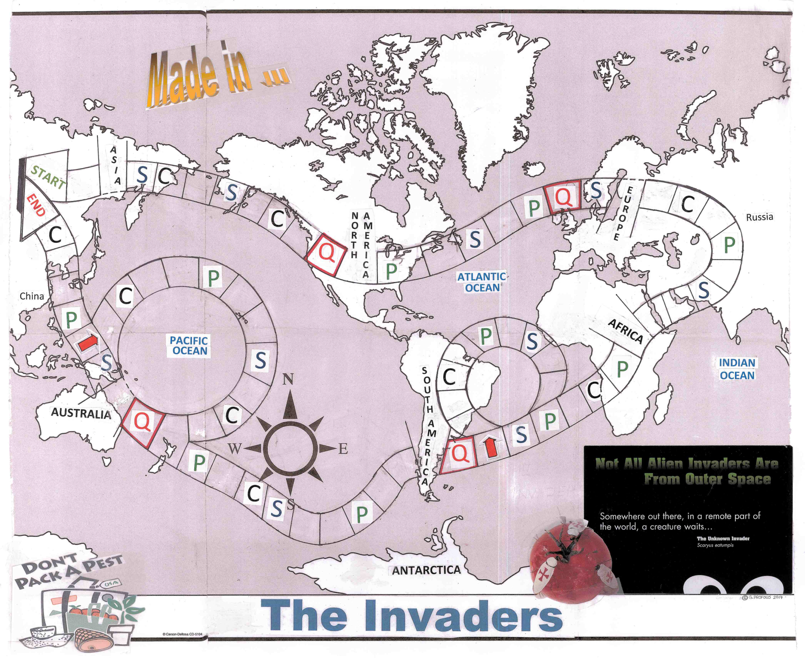

Slide 9
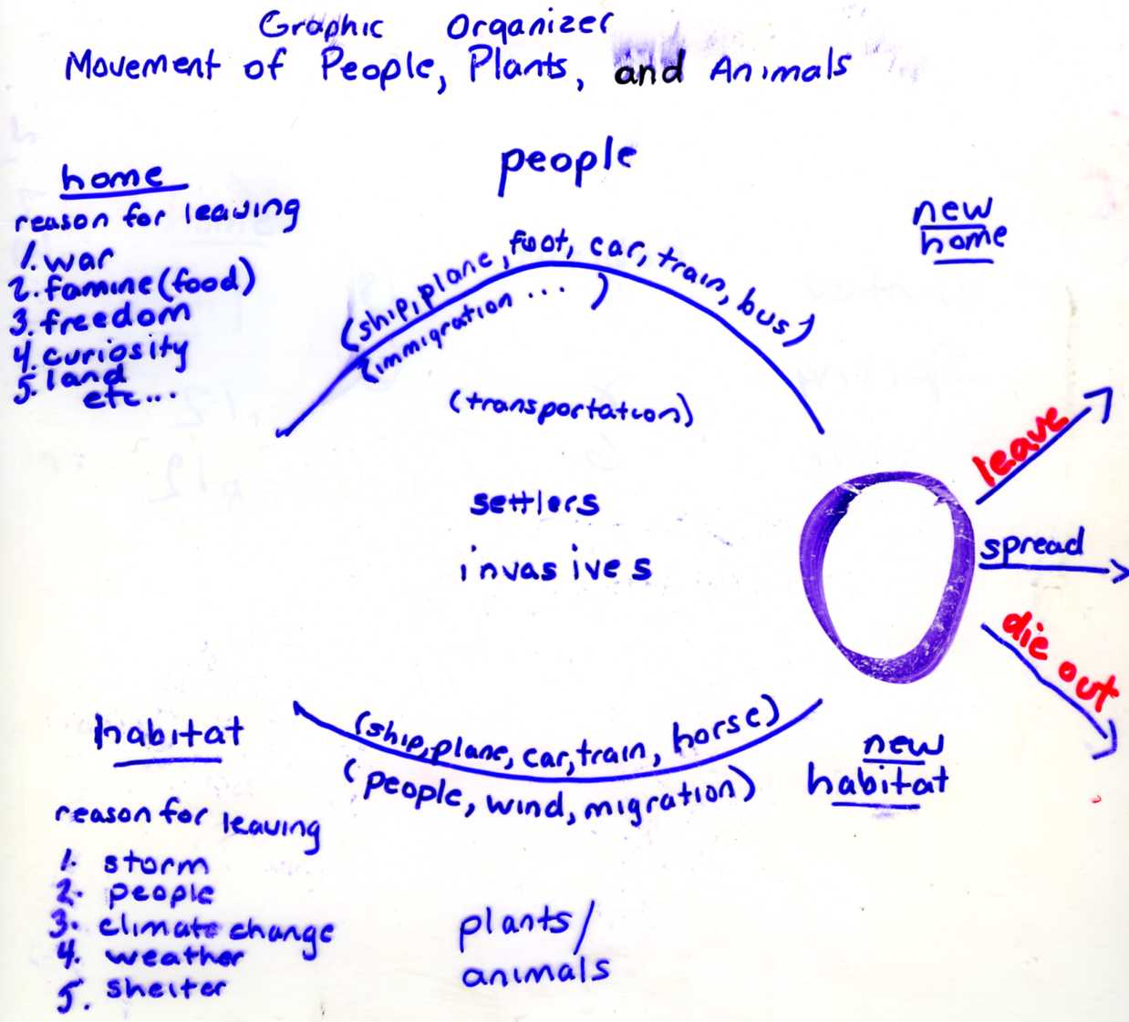

Slide 10
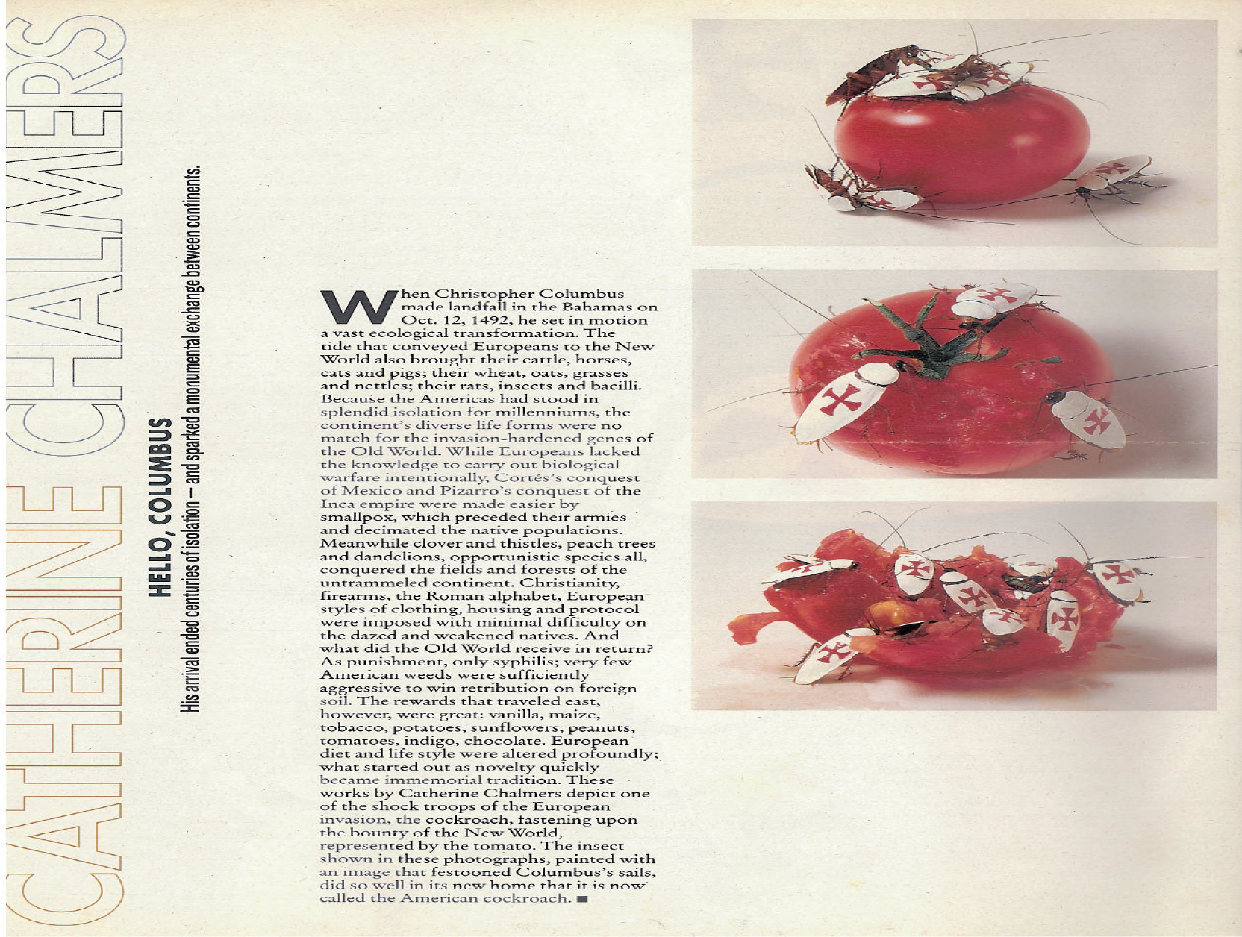
People have been moving stuff around the world for thousands of years. The Native Americans did it. The European explorers did it. The ancient Egyptians, Chinese and Polynesians did it. Every year more and more stuff moves around the world.

Slide 11
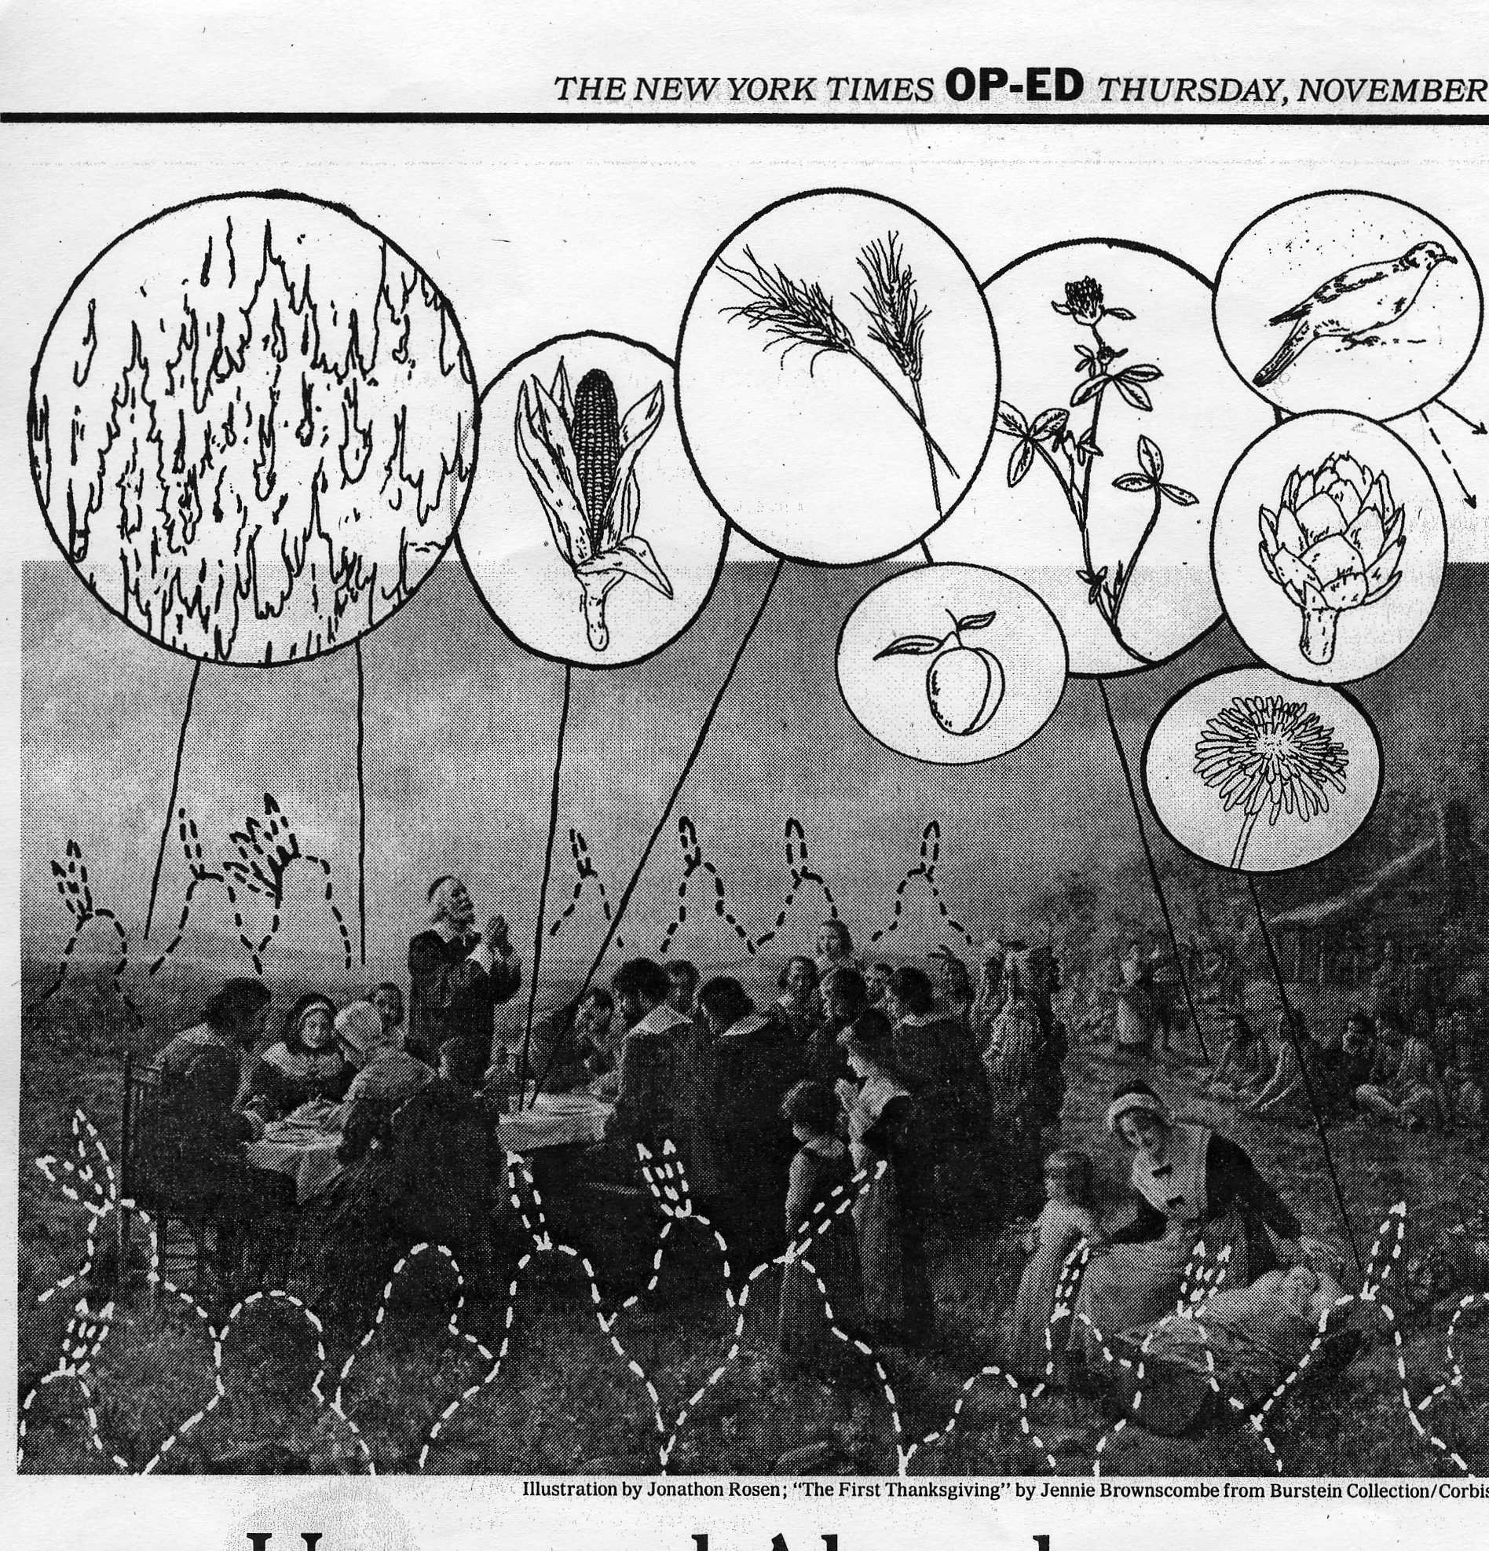
Other Materials
New York Times Op-Ed ,
The First
Thanksgiving
Charles C. Mann, Unnatural Abundance,
November 24, 2004)

Slide 12
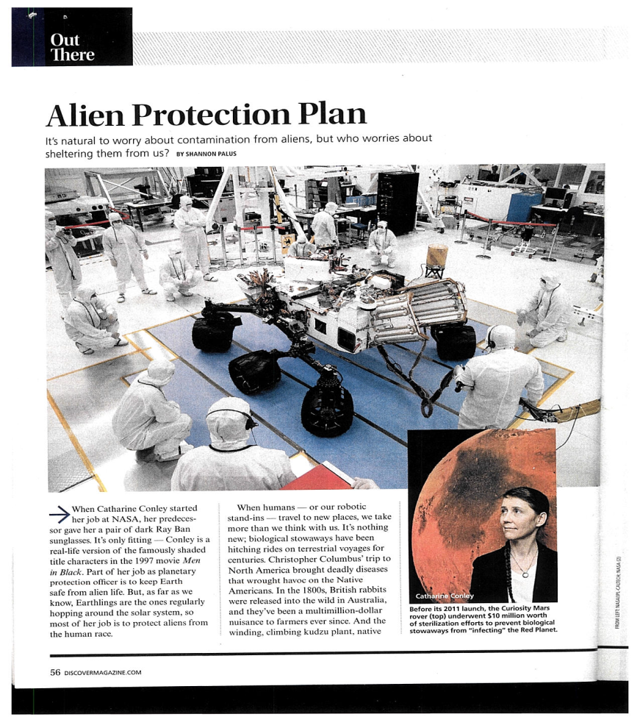
IN THE FUTURE: SCIENCE OR SCIENCE FICTION?
Foundation and Empire, Isaac Asimov
Landing at the planet Sayshell, Chapter 11:
“First, though, there’s a little matter of the ecological balance. Every planet has its own and they don’t want it upset. So they make a natural point of checking the ship for undesirable organisms, or infections. It’s a reasonable precaution.”
“We don’t have such things, it seems to me.” (No invasives on board their ship. The ‘Foundation Planet’ is technically highly advanced)
No we don’t and they’ll find that out. Remember too, that Sayshell is not a member of the Foundation Federation, so there’s certain to be some leaning over backward to demonstrate their independence.” (Define tarrifs, protectionism, trade, trading partners, nationalism, protectionism-all affect the movement of invasives.)
NOW

Slide 13
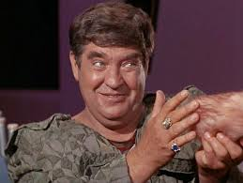
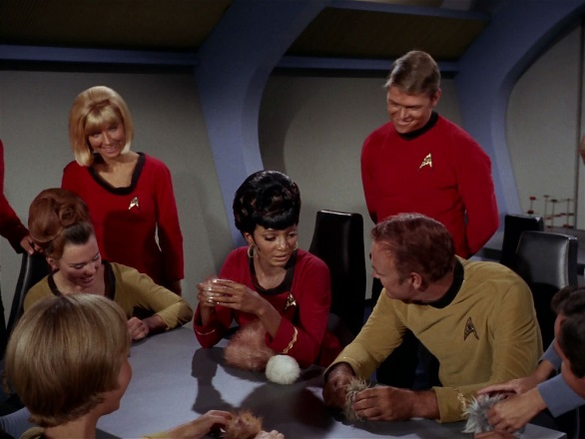

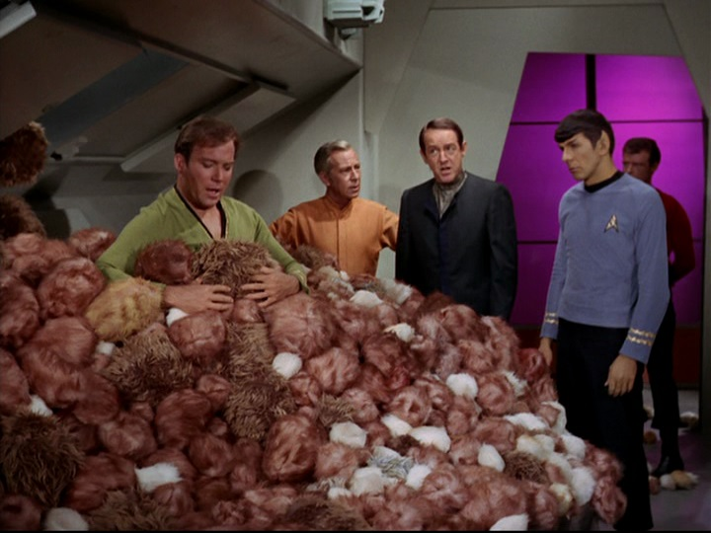
Star Trek
Segment from Star Trek Episode: 3:03:36-3:04:30, 18:57:55 (breed quickly), 19:23:21 – 19:24:05 (remove tribbles from natural habitat). 15:05:05-15:05:52 (removal takes 17.9 years)

Slide 14
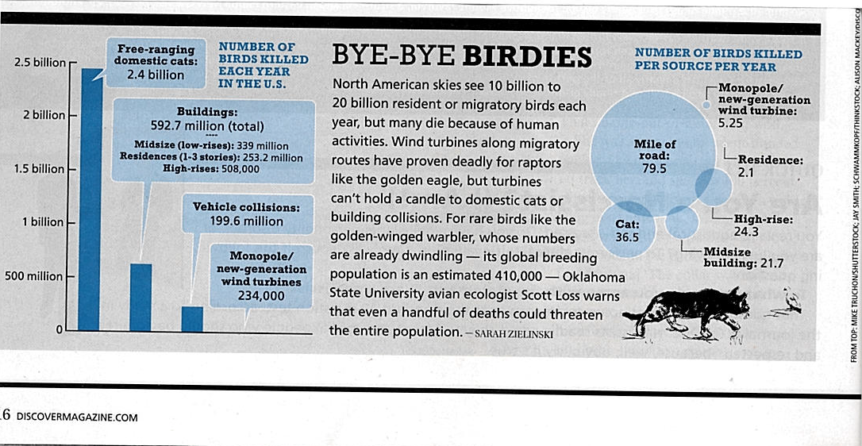
CATS
Notes:
Pitcairn Island Rats-Cats- Birds

Slide 15
Pitcairn Island
AN INVASIVE STORY
There once was an island
to which people accidentally brought rats.
With so many rats,
the people decided to bring some cats.
But the cats ate too many birds.
So the people poisoned the rats
and removed the cats.
But the rats returned,
and now the people applaud
the return of the cats.
Source: Pitcairn News, 7/21/2000 (Pitcairn Islands Study Center)

Slide 16
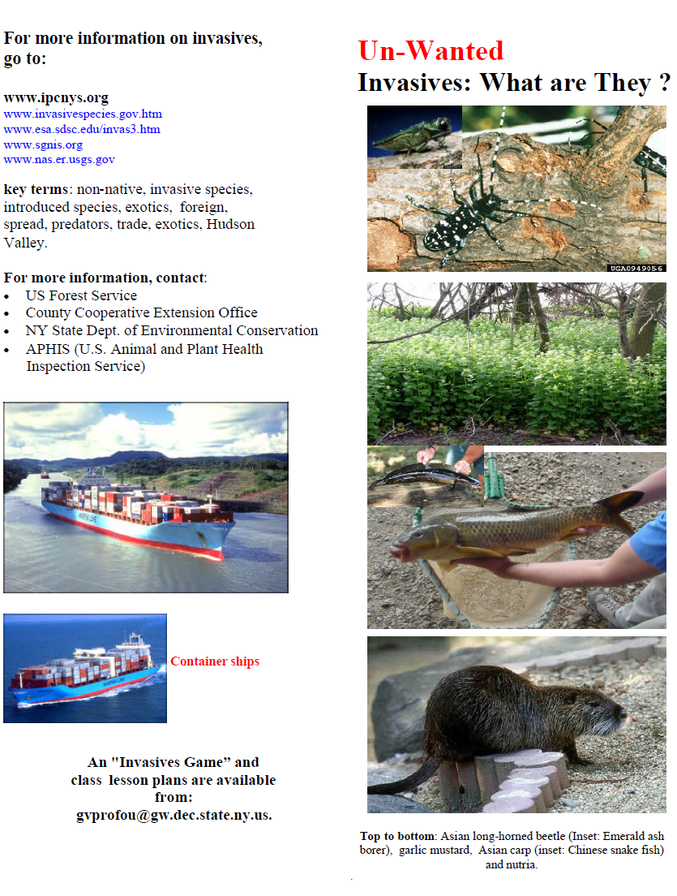
Un-wanted:
Invasives,
What are They?
George Profous, 2010

Slide 17
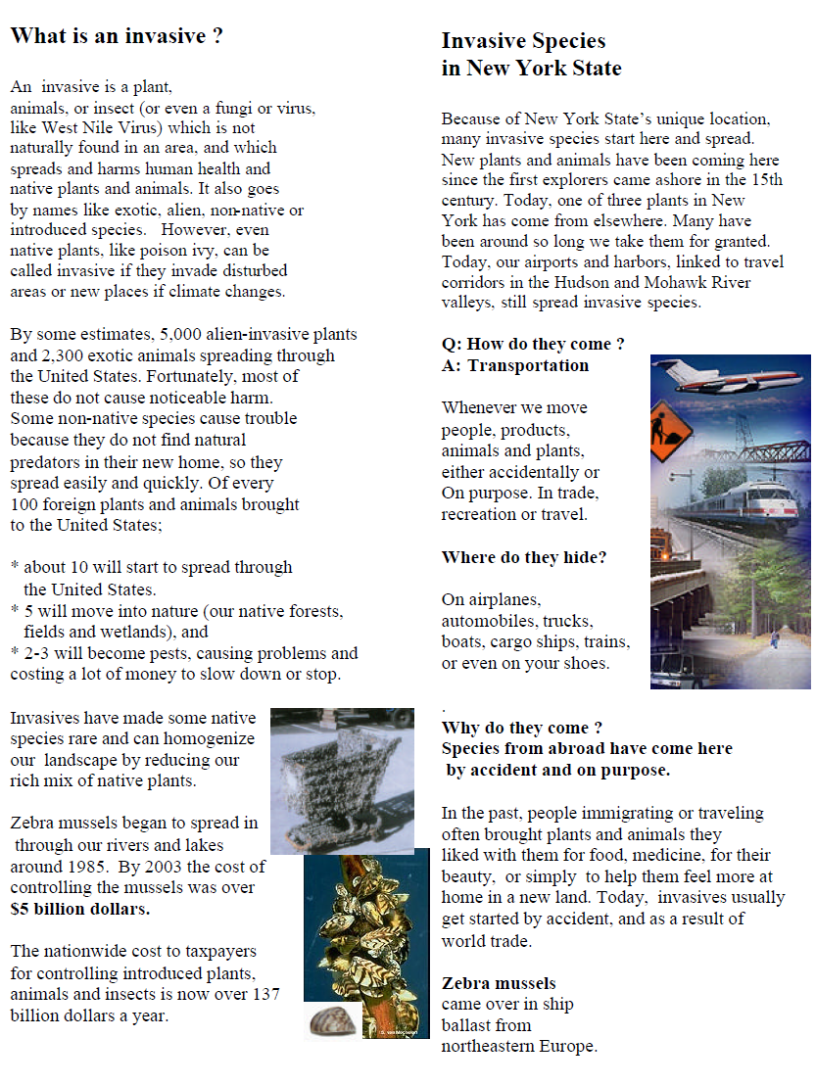
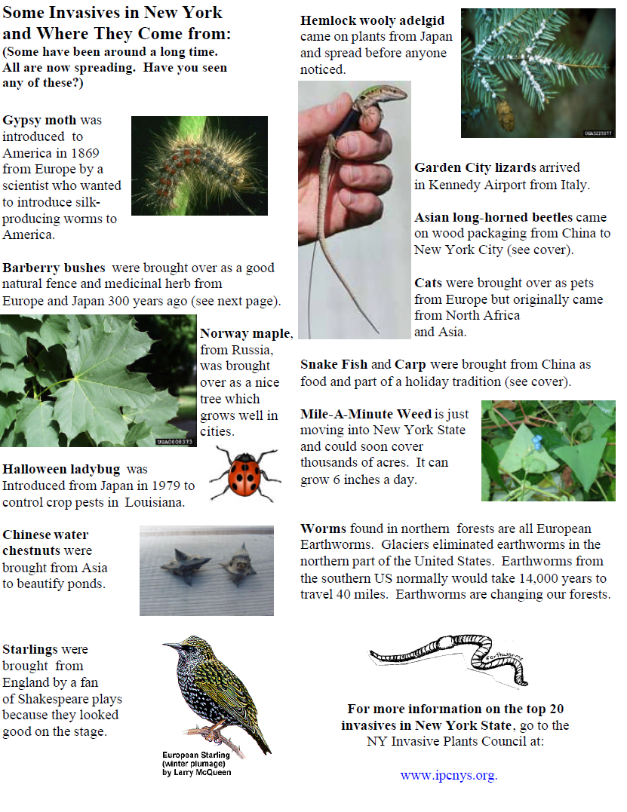

Slide 18
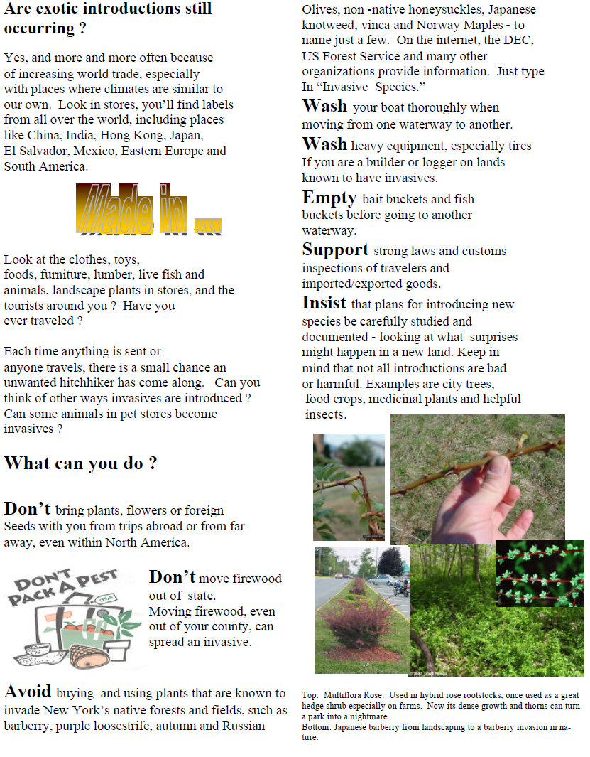
G.Profous, 2010

Slide 19
Name_____________________________________Date________________________
Answer the following questions using the “Un-wanted Invasives: What Are They ?” Brochure
Fill in the blanks:
1. ______out of every 3 plants in New York State are from another country.
2. By the year 2003, controlling zebra mussels cost more than ___________________
(5 million, 50 million, 5 billion).
3. List 6 ways non-native (invader) plants and animals hide and enter the United States ________________, ______________________, ________________________, ___________________, ________________________, ______________________.
4. Circle the most appropriate answer.
Why have animals from other countries been brought (introduced) into the United States?
food
medicine
landscaping
by accident
nostalgia
All of the above

Slide 20
5. Fill in the blanks:
Barberry bushes came from ________________________________.
The Halloween Ladybug is from _____________________________.
Starlings are from________________________________.
Cats first came from_________________________________.
North Africa
Europe
Japan
England
6. Answer True (T) or False (F)
_____SMART trade is the best way to stop invading plants and animals.
_____Any plants and seeds from other countries make wonderful gifts for friends.
_____Don’t plant invasive landscape plants like barberry and purple loosestrife.
_____Moving firewood long distances is a good idea.
_____Invading plants and animals usually have many predators.
.

Slide 21
